Slide 1

Team Name : Silicon Vaikuntha.exe
Team Leader Name : Dhanya J Nadig
Problem Statement : Designing a Chain-of-Thought-Based LLM System for Solving Complex Spatial Analysis Tasks Through Intelligent Geoprocessing Orchestration

Slide 2

Team Members
Team Leader: Name: Dhanya J Nadig College: Dayananda Sagar Academy of Technology and Management | Team Member-1: Name: Monish.R College: Dayananda Sagar Academy of Technology and Management
Team Member-2: Name:Rituraj Singh College: Dayananda Sagar Academy of Technology and Management | Team Member-3: Name: Prashanth A N College: Dayananda Sagar Academy of Technology and Management

Slide 3
Brief about the Idea:
BodhRishi is a new system that uses a Large Language Model (LLM) to automatically create and run GIS workflows from natural language queries. It connects complex geospatial data with users. This way, it makes spatial analysis faster, simpler, and smarter.

Slide 4
Opportunity should be able to explain the following:
Democratizing Spatial Intelligence: Making GIS Accessible to All
How different is it from existing ideas?
Most current solutions are either rule-based systems with limited flexibility or require a lot of coding knowledge. We use a Chain-of-Thought LLM, which can reason through complex spatial problems and adapt workflows as needed. Unlike existing tools, we use RAG with GIS knowledge to give the LLM the necessary context.
How will it be able to solve the problem?
It interprets user queries, breaks them down into logical steps, and creates a custom GIS workflow. The system then runs this workflow automatically, producing meaningful results and visualizations.
Unique Selling Points of the proposed solution:
Natural Language Interface: Simple and easy to use for non-experts.
Automated Workflow Generation: LLM reasons through the problem without pre-defined templates.
GIS Knowledge Integration: RAG system provides relevant spatial context and best practices.
End-to-End Automation: From query to results, minimizing manual work.
Chain-of-Thought Reasoning: Increases reliability and traceability.

Slide 5
List of features offered by the solution
Unlock the Power of Location Intelligence with BodhRishi's Features:
List of Features:
Natural Language Query Processing: Understand complex spatial requests.
Chain-of-Thought Reasoning: A step-by-step problem-solving approach.
Automated Workflow Generation: Creates GIS workflows in JSON or YAML format.
RAG System Integration: Improves the LLM with relevant GIS knowledge.
Workflow Execution Engine: Automatically runs generated workflows using GIS libraries.
Data Source Integration: Access OSM, Bhoonidhi, and other data sources.
Interactive Streamlit Interface: A user-friendly platform for analysis.
Result Visualization: Display outputs on interactive maps and charts.

Slide 6
Process flow diagram or Use-case diagram
User Input: User enters a natural language query through the Streamlit UI.
LLM Reasoning (CoT Engine): LLM processes the query by using Chain-of-Thought and checks RAG to create a workflow.
Workflow Generation: LLM provides a structured workflow in JSON format.
Workflow Execution: Workflow Engine carries out the steps using GIS libraries, such as GeoPandas, QGIS, and Rasterio.
Data Access: System retrieves needed data from sources like OSM, Bhoonidhi, and local files.
Output & Visualization: Results appear in the Streamlit UI, including maps, charts, and data.

Slide 7
Wireframes/Mock diagrams of the proposed solution (optional)
Under the Hood: A Modular and Scalable Architecture with
Complete LLM Engine with Llama-3.1-8B-Instruct integration
RAG System for GIS knowledge retrieval
Workflow Executor for running generated workflows
Streamlit Interface for user interaction
Comprehensive Evaluation Framework
Data Integration for OSM and Bhoonidhi
Deployment Instructions and configuration
Performance Optimization utilities

Slide 8
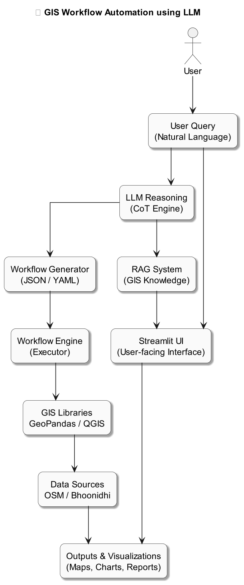
Architecture diagram of the proposed solution

Slide 9
Technologies to be used in the solution:
Powered by Cutting-Edge Technologies
List of Technologies:
Large Language Model: Llama-3.1-8B-Instruct
Programming Language: Python
GIS Libraries: GeoPandas, Rasterio, Folium, OSMnx
LLM Framework: Langchain
Vector Database: FAISS
Embedding Model: Sentence Transformers
User Interface: Streamlit
Data Sources: OSM, Bhoonidhi APIs

Slide 10
Estimated implementation cost (optional):
Cost-Effective Geospatial Intelligence with BodhRishi
LLM Hosting Costs (e.g., cloud GPU costs)
Data Storage Costs
Development Time (Your Hackathon Time)
Possible API Costs (depending on data source usage)

Slide 11
Benefits & Impact
Transforming Spatial Analysis: Faster, Smarter, and More Accessible with BodhRishi
Increased Efficiency: Automate complex workflows, which saves time and effort.
Improved Accuracy: Chain-of-Thought reasoning reduces errors.
Better Accessibility: Help non-experts with powerful spatial analysis tools.
Data-Driven Decision Making: Get deeper insights from geospatial data.
Faster Response to Critical Needs: Allow quick analysis for disaster response, urban planning, and more.

Slide 12
